Slide 1
Pharmacy Management
Web Technology Prject

Slide 2
Group Members & Roles
Amna Pervaiz (21-Arid-552) - Backend
Ayesha Majeed (21-Arid-560) - Frontend
Alishba Khurshid (21-Arid-546) - Database

Slide 3
Technologies
HTML 5
CSS
Bootstrap
PHP

Slide 4
Frontend Results

Slide 5

Home Page

Slide 6
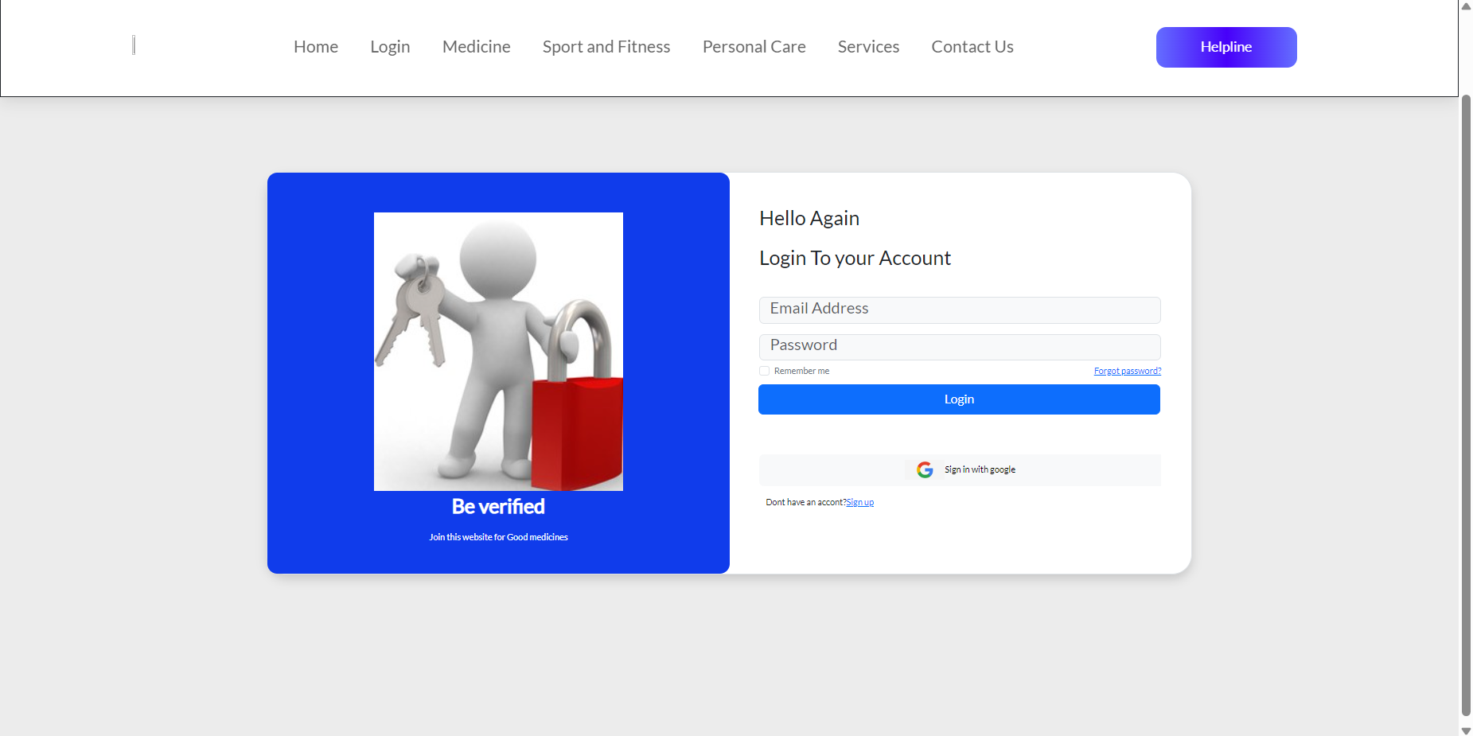
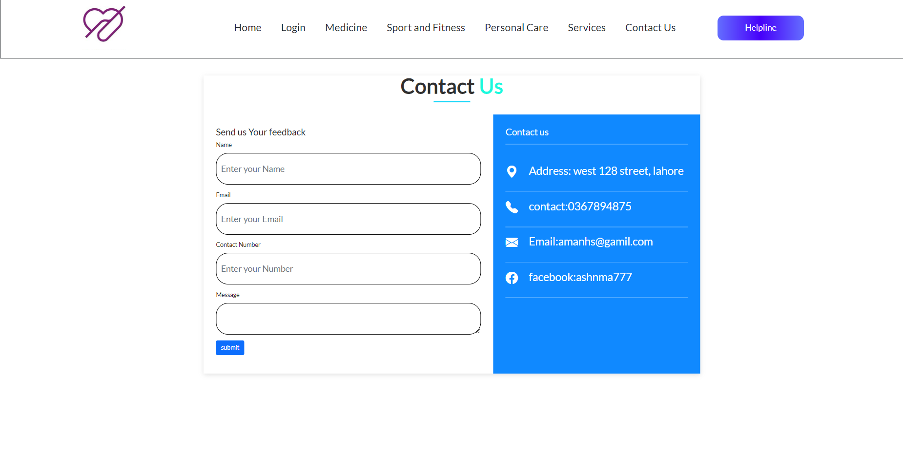
Signup & Contact US

Slide 7
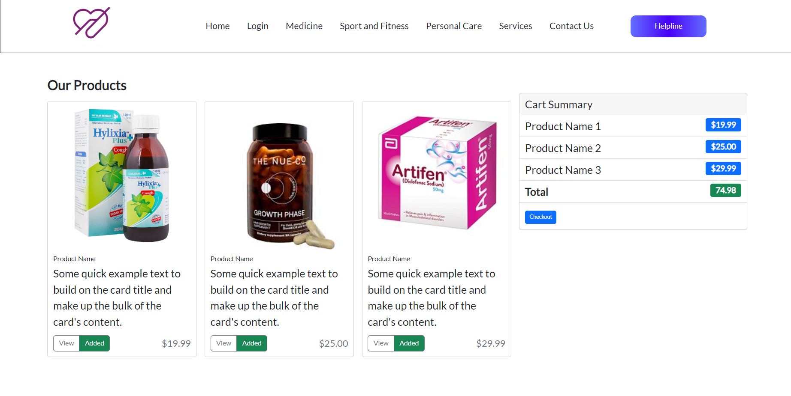
Cart

Slide 8
Backend & Database

Slide 9
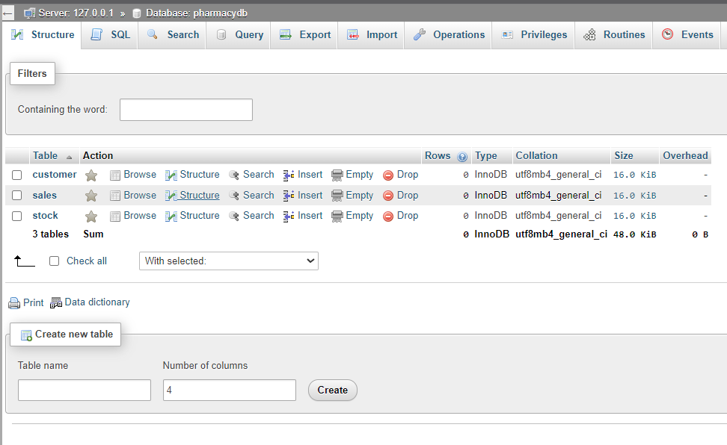
Database Details
PRESENTATION TITLE
9

Slide 10
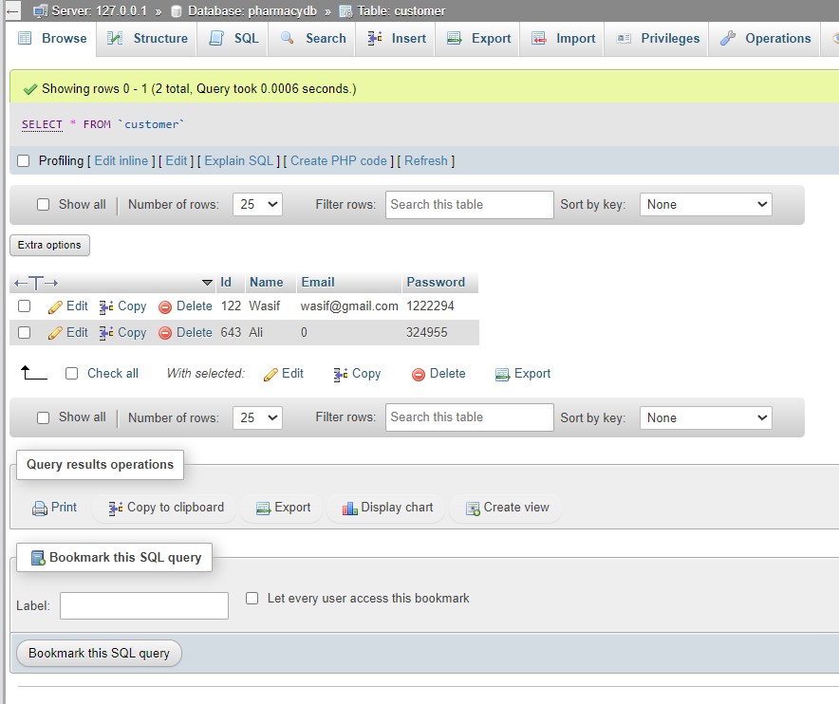
User Details
PRESENTATION TITLE
10

Slide 11
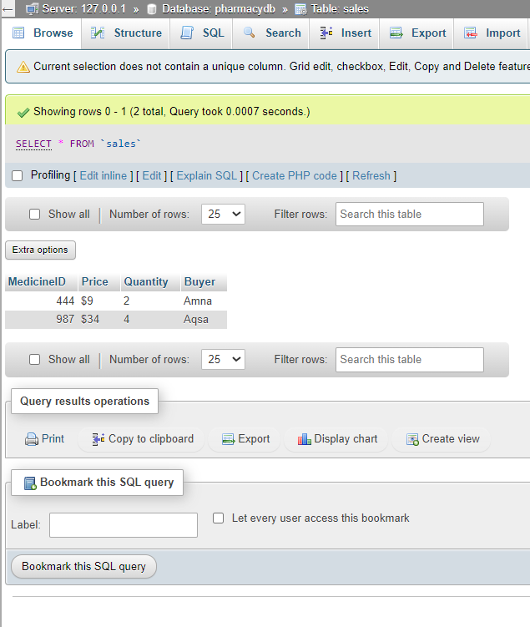
Sale Details
PRESENTATION TITLE
11

Slide 12
Thank you

